Slide 1
Credit Risk Analysis
Understanding the various insights from the historical data which are more prone to loan getting defaulted.
Having an idea about various characteristics leading to loan defaulters.

Slide 2
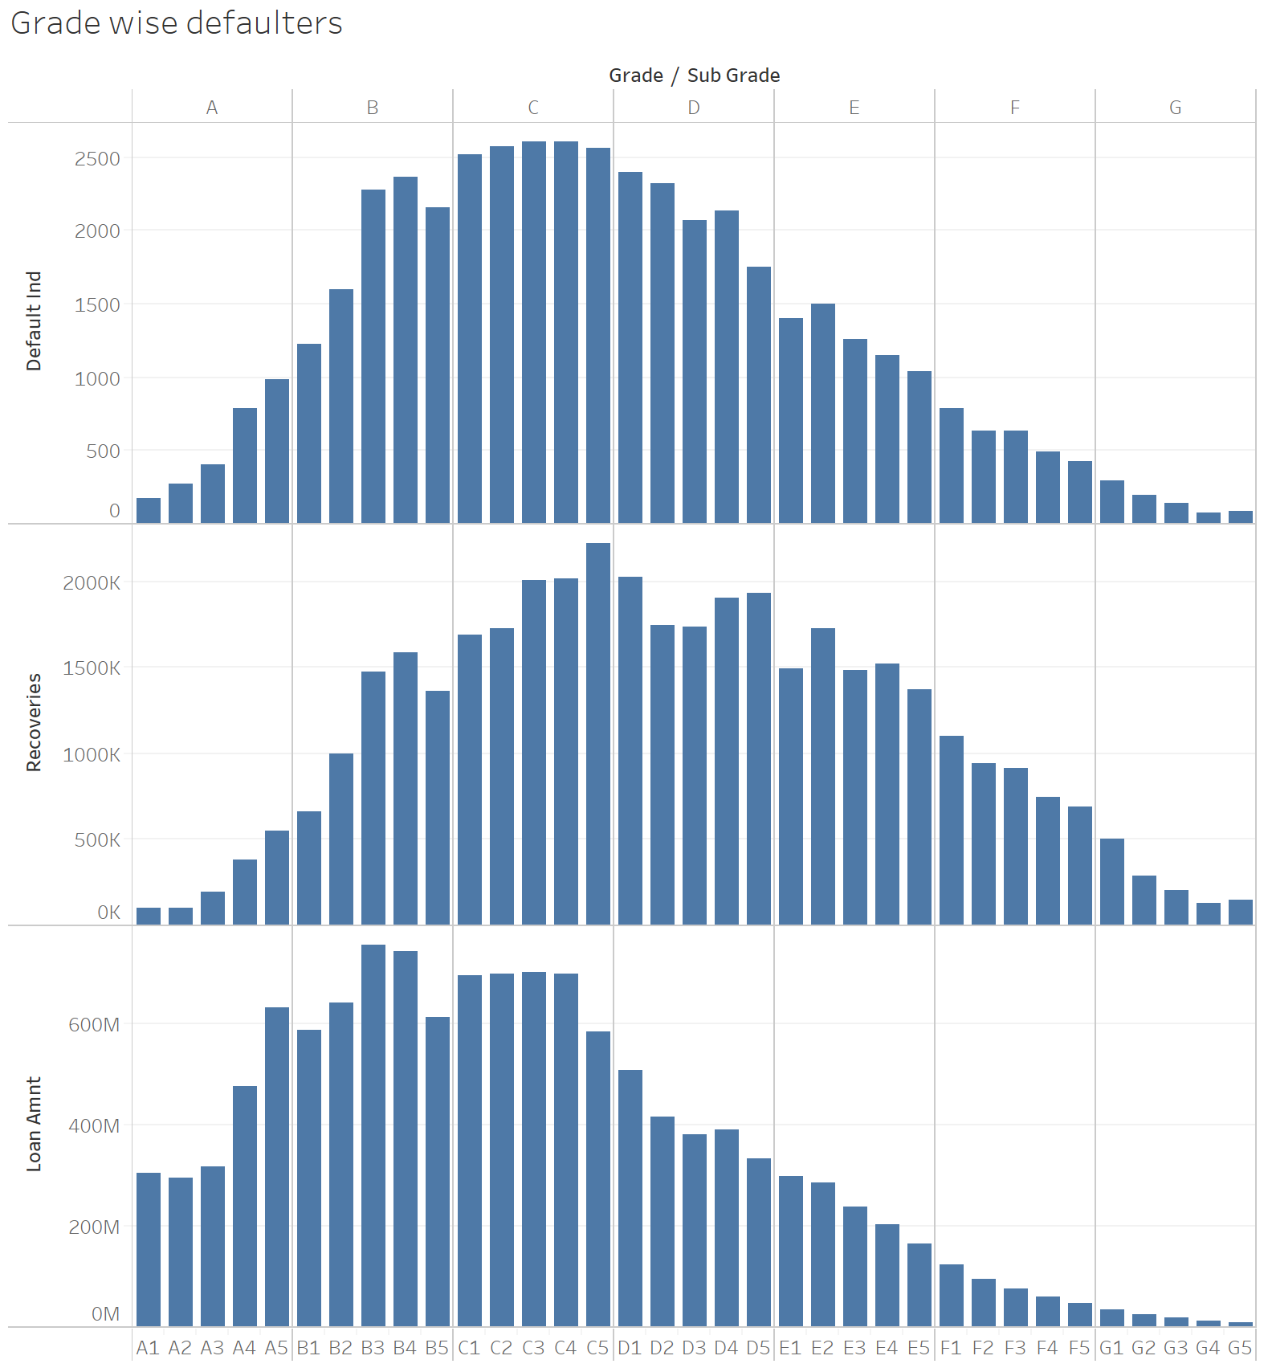
It can be observed that the customers falling under grade C
category have the highest number of loan defaulters.
Although the maximum number of loan defaulters are under
grade C customers, the recovery amount is spread across
grade C and D.
We have seen that the defaulters are high in grade C category
however, when we see the distribution of loan amount, it’s the
grade B which tops the list.

Slide 3
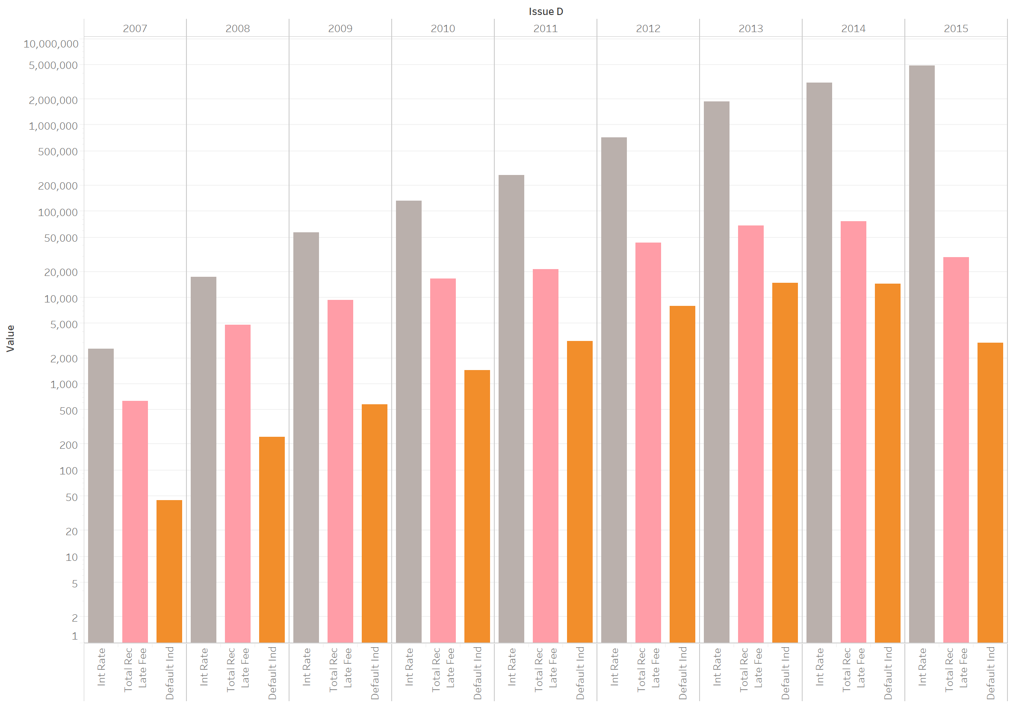
We saw the distribution of
Interest Rate
Total Received Late Fee
Count of Defaulted Loans
across the data available for
the whole period 2007-2015.
It was interesting to see that
the interest rate did grow with
time as per the expectations
however, the number of people
defaulting the loans started to
see a fall from 2013-2014.

Slide 4
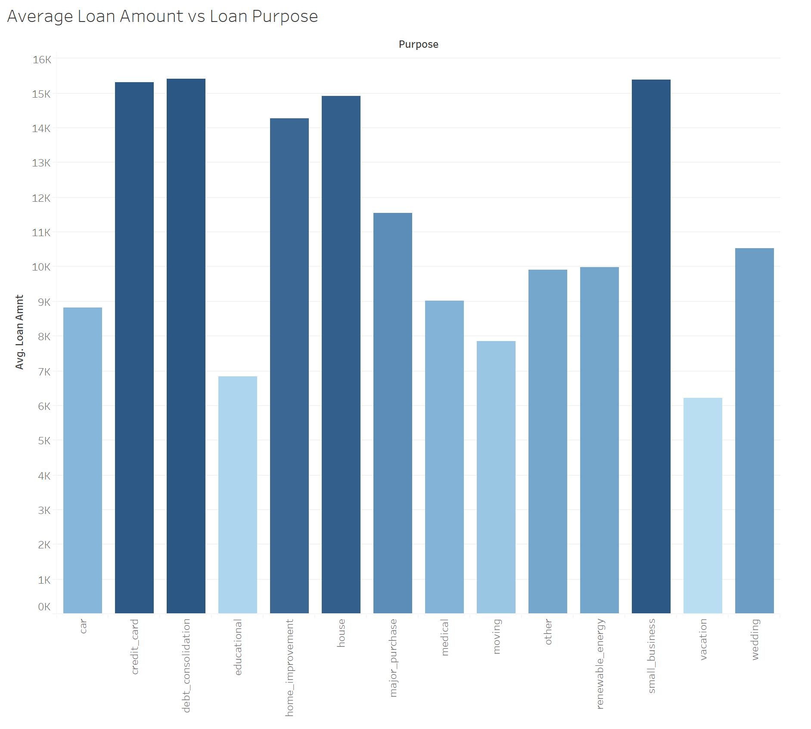
We tried to see what all types of loans were mainly taken by the customers and it was found that average loan amount was around 15K and it was mainly for three reasons:
Debt Consolidation
Credit Card
Small Business
It was surprising to see that the average loan amount for education was one of the lowest in the categories.

Slide 5
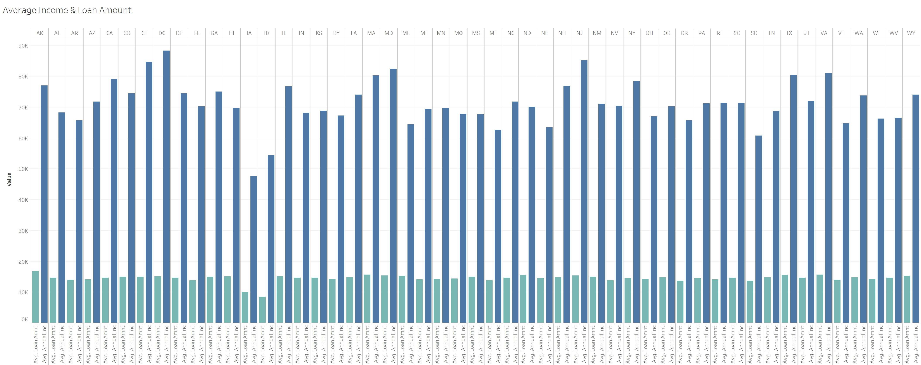
We tried to see the distribution of the average annual income and the loan amount that each of the states held and it was
found that the smaller states like Idaho & Iowa had the lowest average loan amounts.

Slide 6
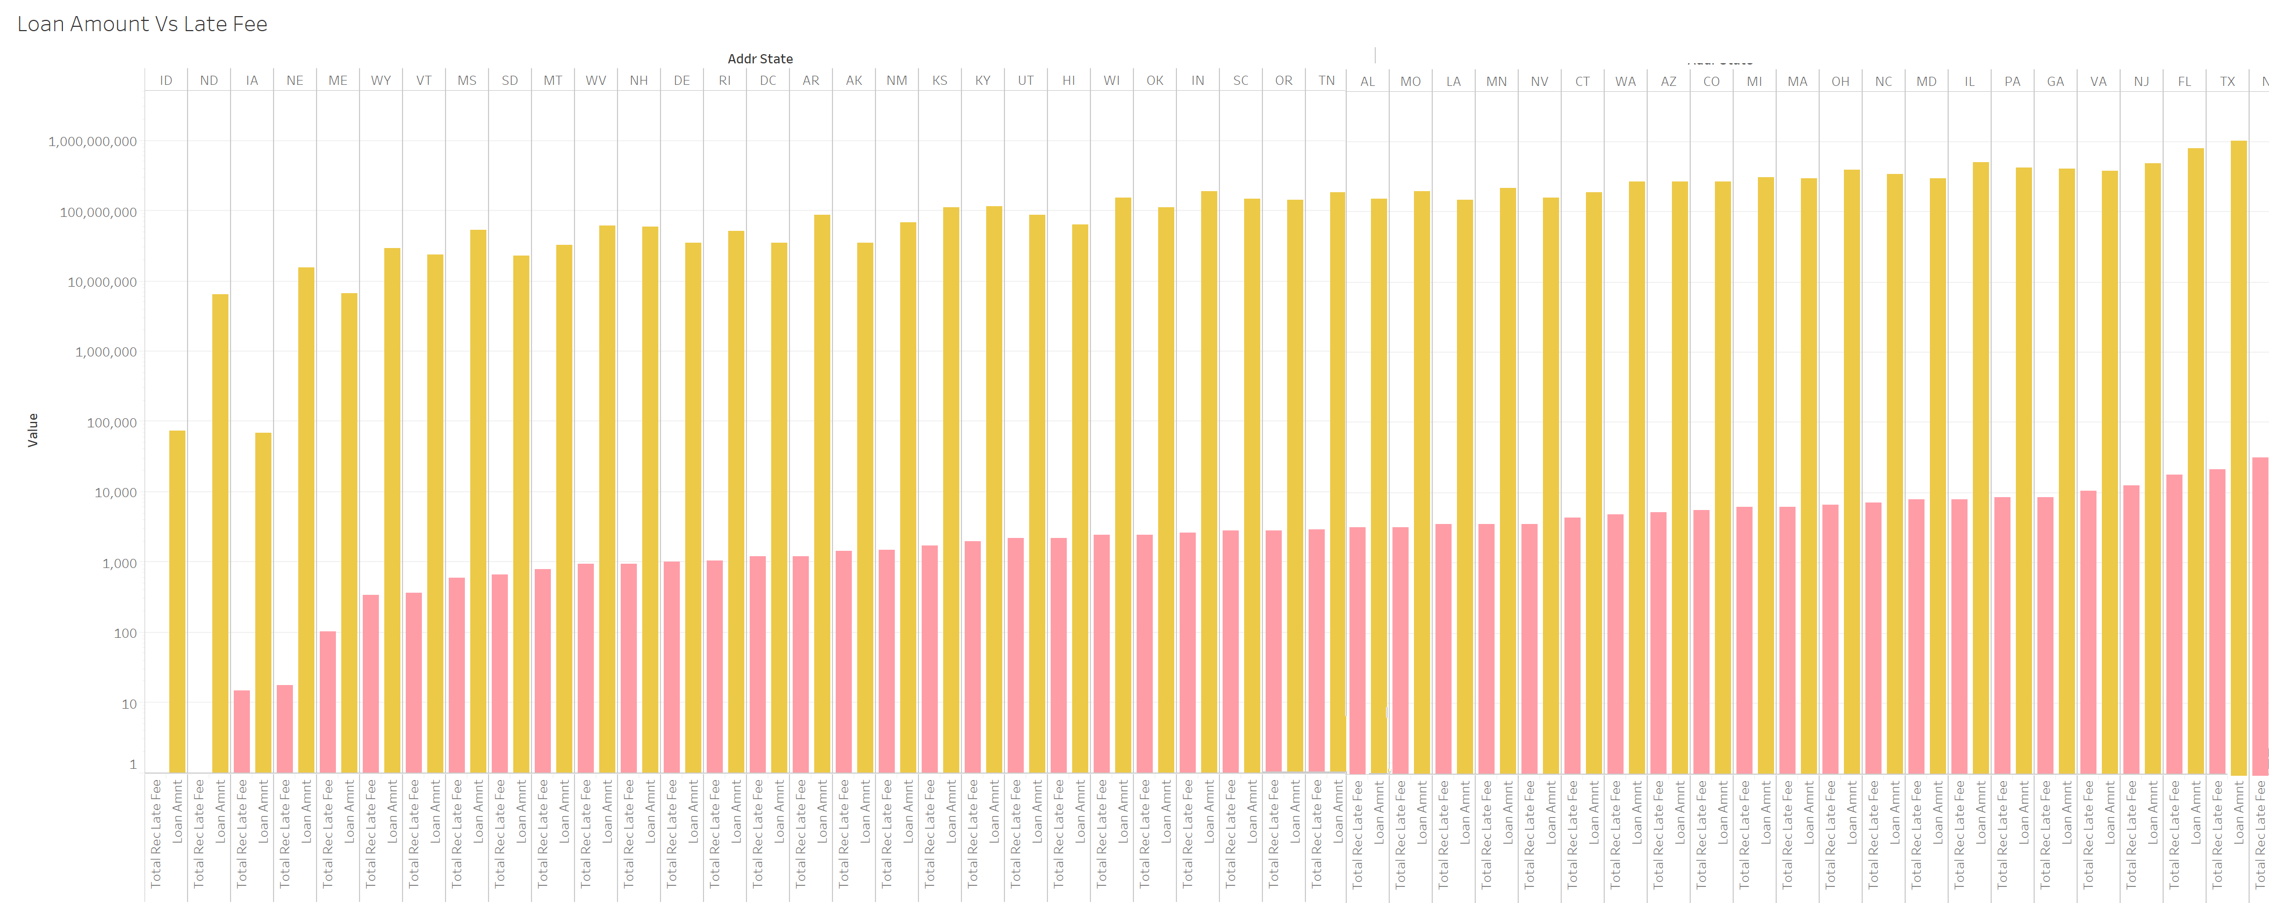
We saw in the previous slide that the smaller state Idaho had low average loan amount and it was also seen in this slide that
Idaho did not have late payments for the loans. Along with Idaho, North Dakota, Iowa, Nebraska also were on the lower side
of the spectrum when it came to the amount that was paid as late for the loan premiums. Whereas states like Texas, Florida,
Illinois, New Jersey topped the chart for maximum number of late payments.

Slide 7
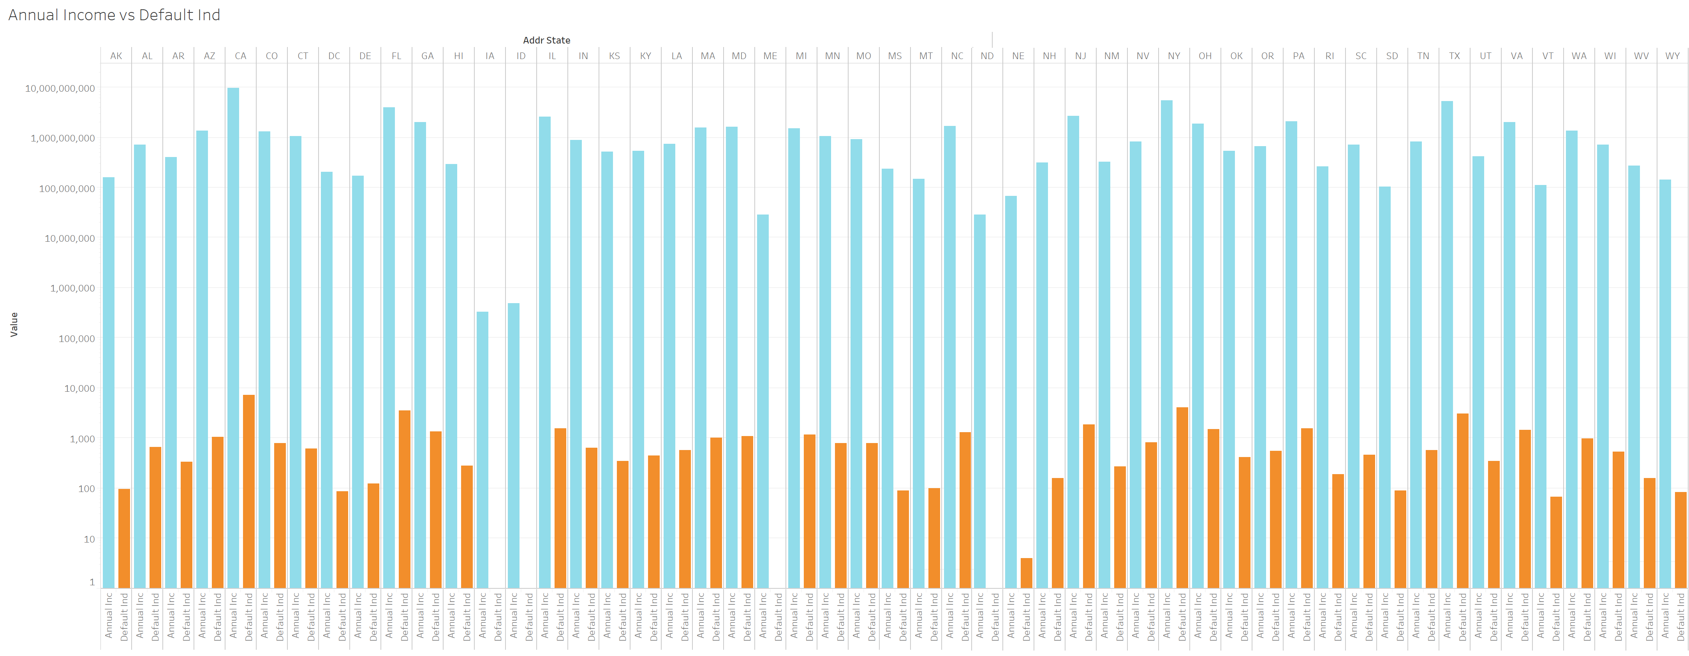
The annual income and the tendency to default a loan was expected to a direct relationship. We tried to study that across
the states and found that states of Iowa, Idaho, North Dakota, Nebraska either did not have any defaulters or the number
was negligible in comparison with other states.

Slide 8
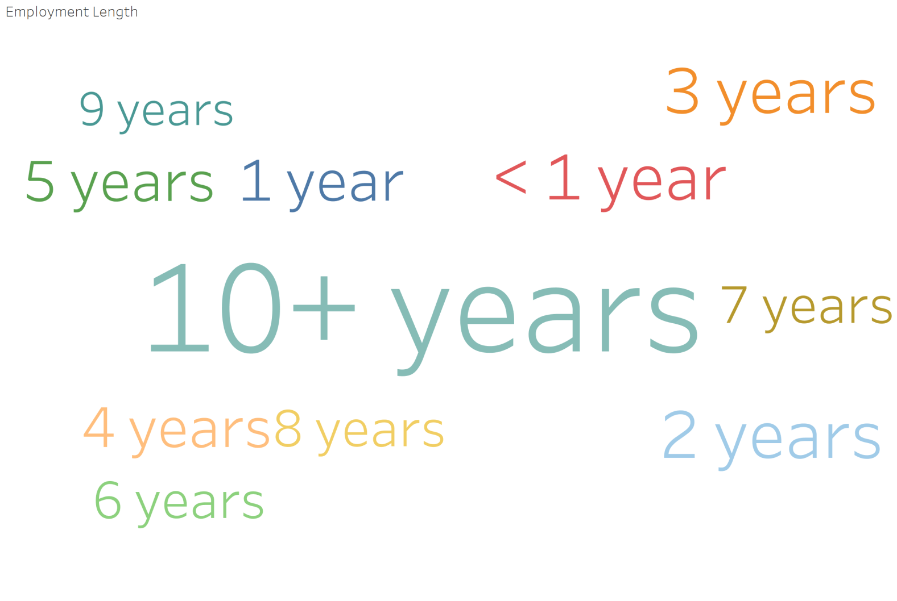
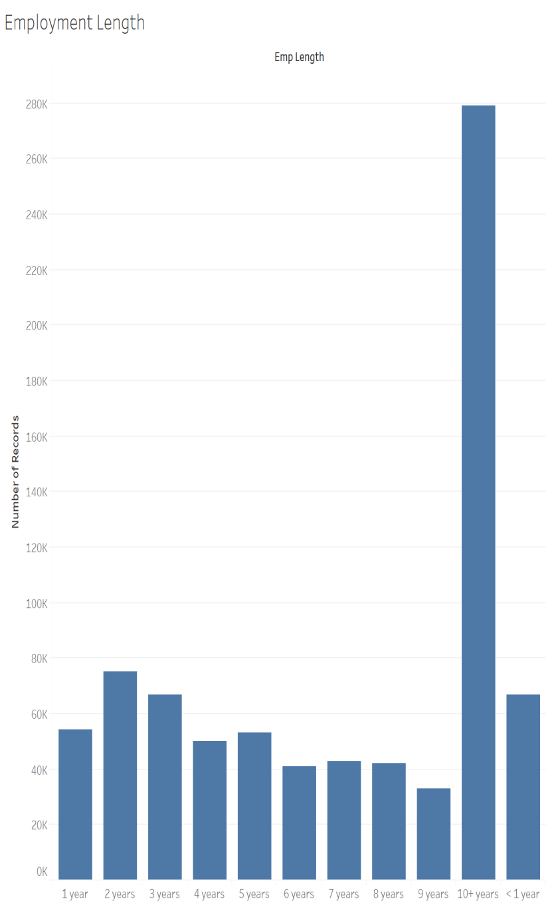
We also tried to analyze the type of people who got the maximum number of loans.
Surprisingly, it was the group of people who had more than 10 years of work experience were way ahead when it came to taking loans.

Slide 9

It really gives immense pleasure to
identify and figure out some surprising
detail from the data.
It was observed that the organization
issued very less number of loans on a Tuesday whereas Saturday seemed to be their favorite day for issuing the loans.

